Slide 1
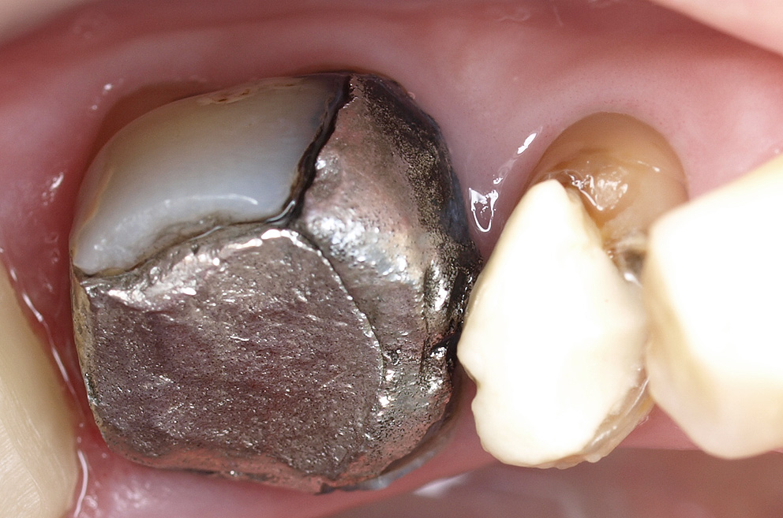
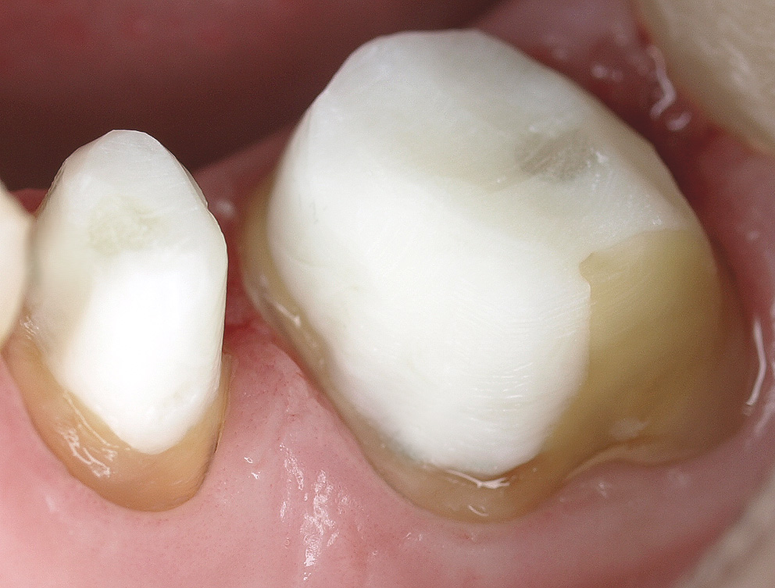
September, 2010
Clinical Case: Macro-Lock Post
Clinical case by:
Dr. Marcelo Balsamo
This patient presented with a failed amalgam and composite restorations. After removal and cleanup, the post spaces were basically round, and flared. There was excessive loss of coronal tooth structure, but sound dentin. The post space was achieved with minimal loss of dentin, revealing a normal, round spaces internally.
The retentive Macro-Lock Post Size #1 was able to accommodate the vacant space, leaving relatively low cement thickness.
This post system was selected because of the anatomic taper in the apical sections, and the reported flexural strength of this post.

Slide 2
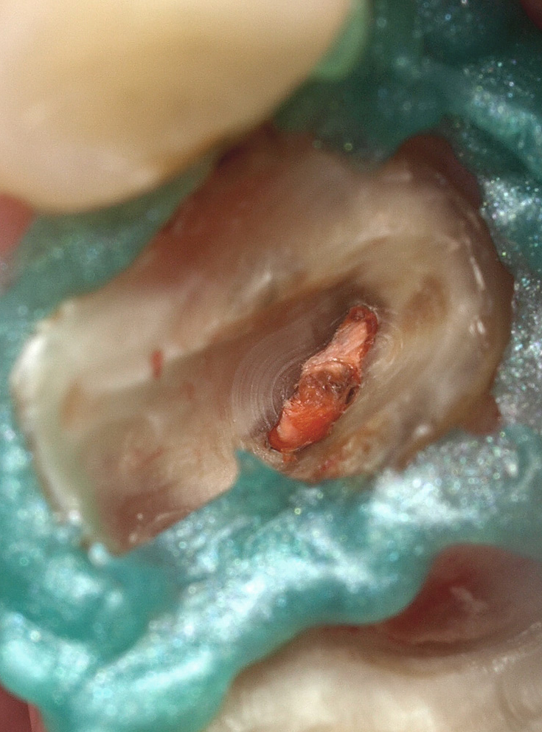
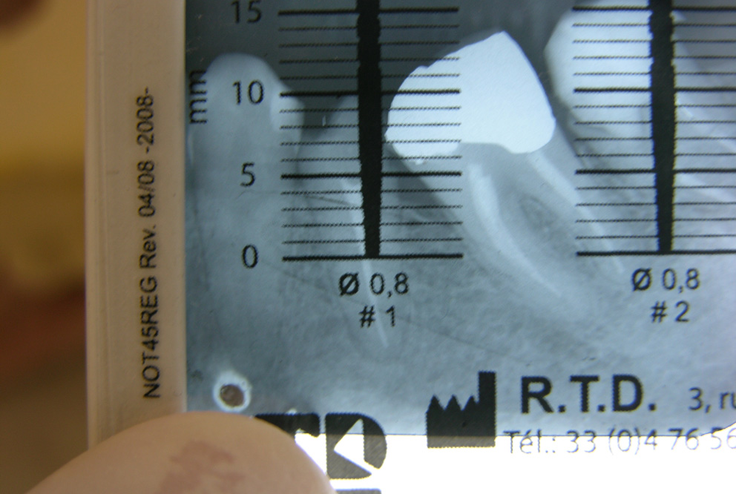
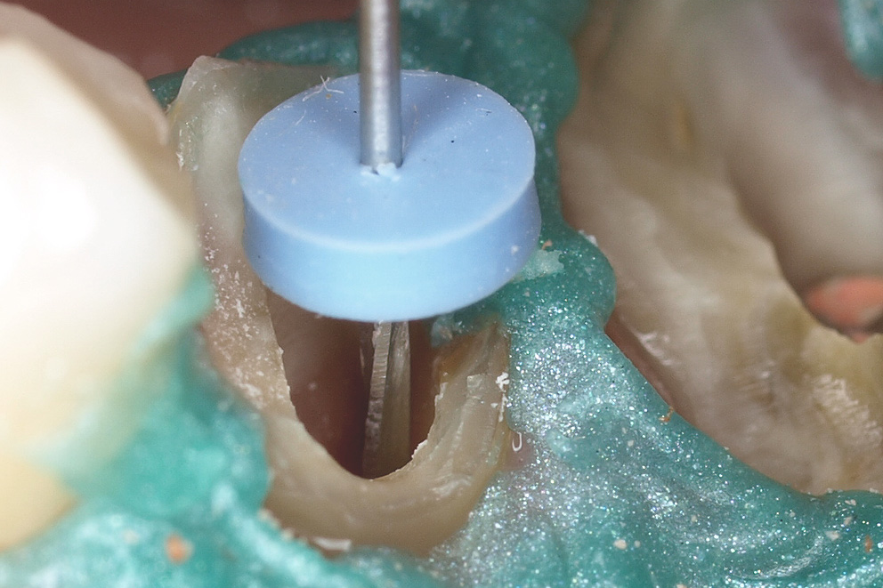
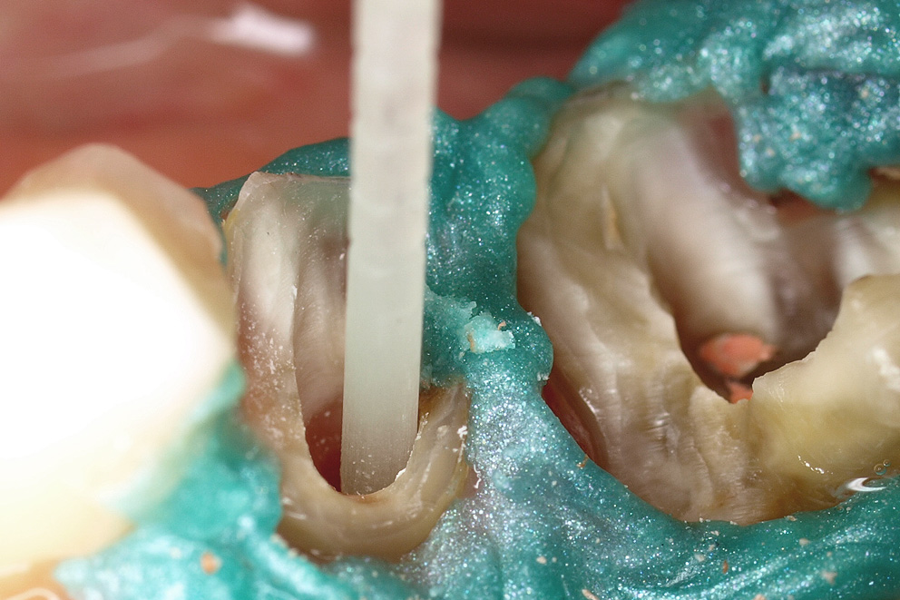
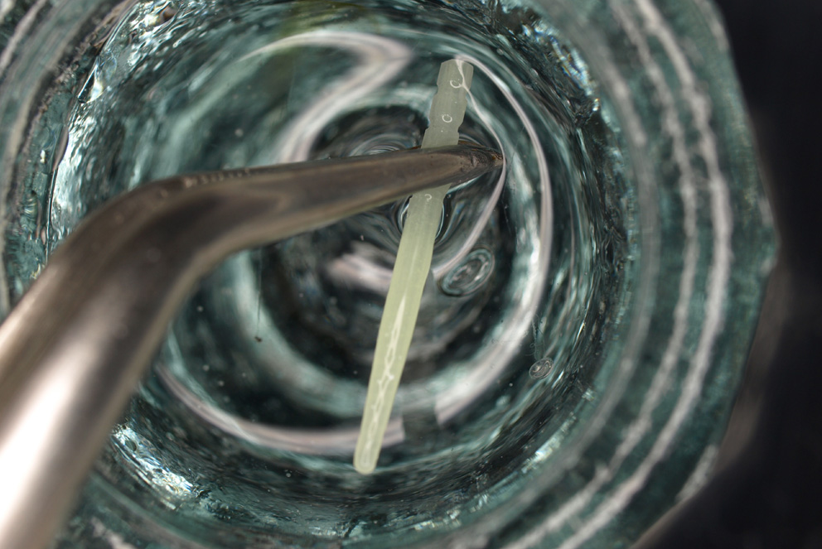
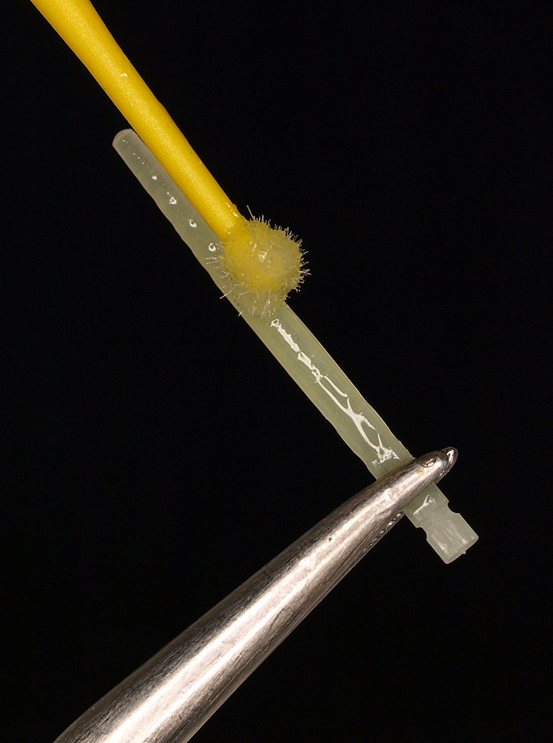
1. Isolate, remove the failed restoration, Gutta Percha, and confirm seal.
2. Determine the most appropriate size with the Selector Guide card provided.
3. Prepare the post space using the Starter and consecutively larger Finishing Drills.
3. Try-in the post, to confirm apical fit, trim excess length. Clean with alcohol.
4. Clean the post with alcohol.
5. Apply adhesive bonding agent on post.
Air-dry. Light-cure.

Slide 3
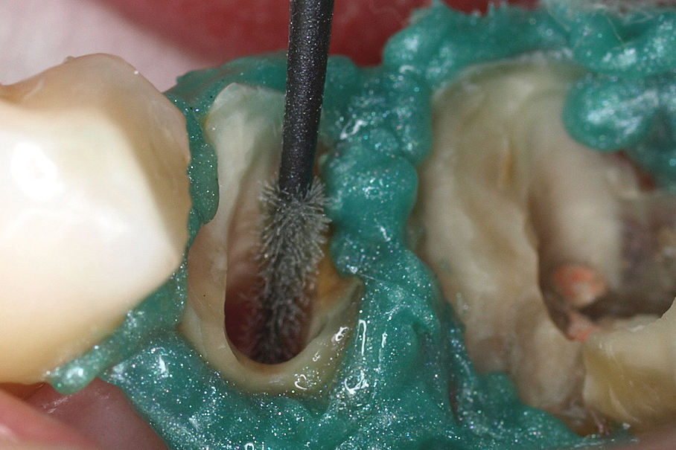
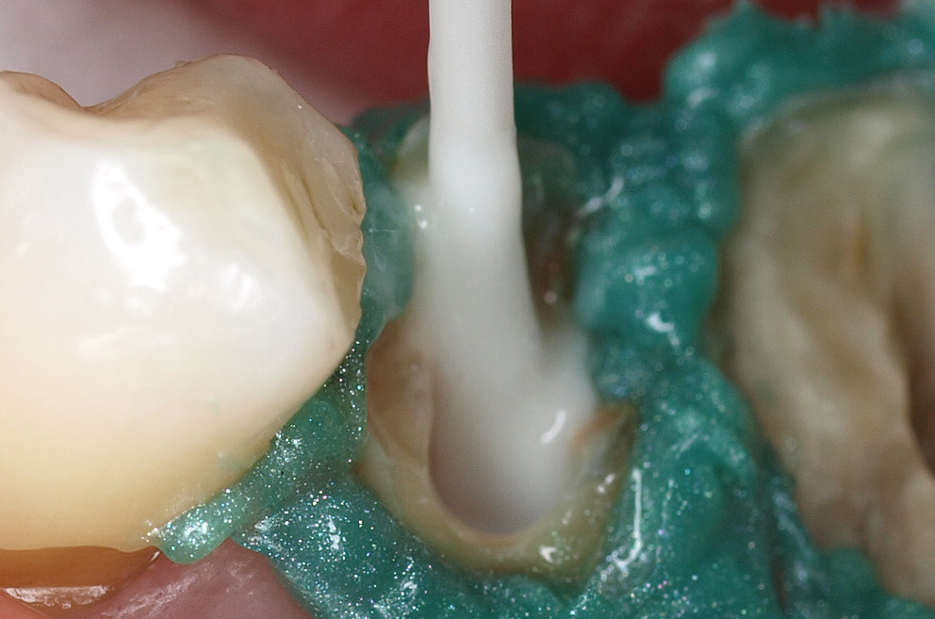
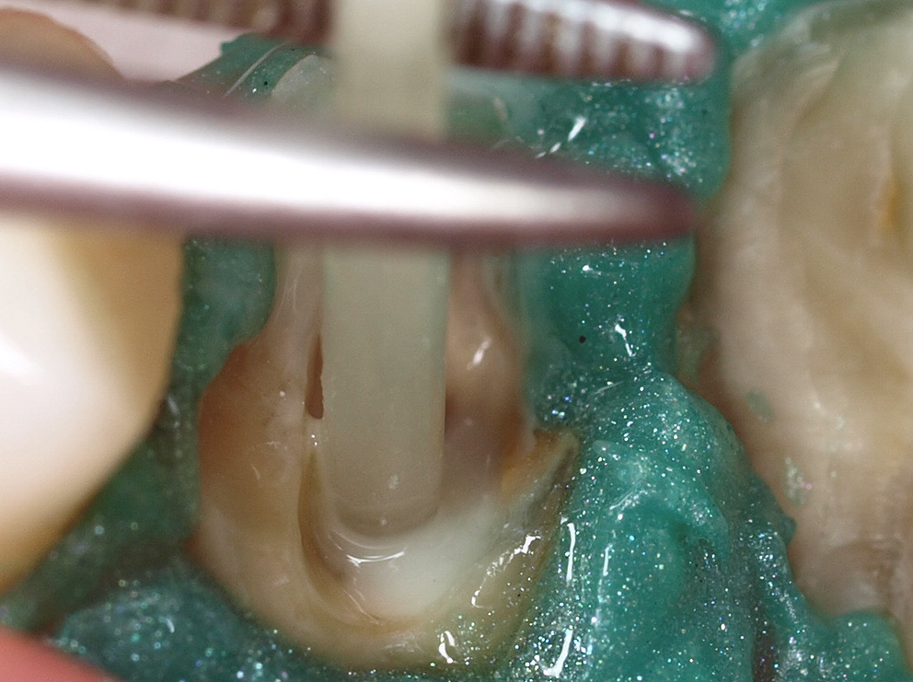
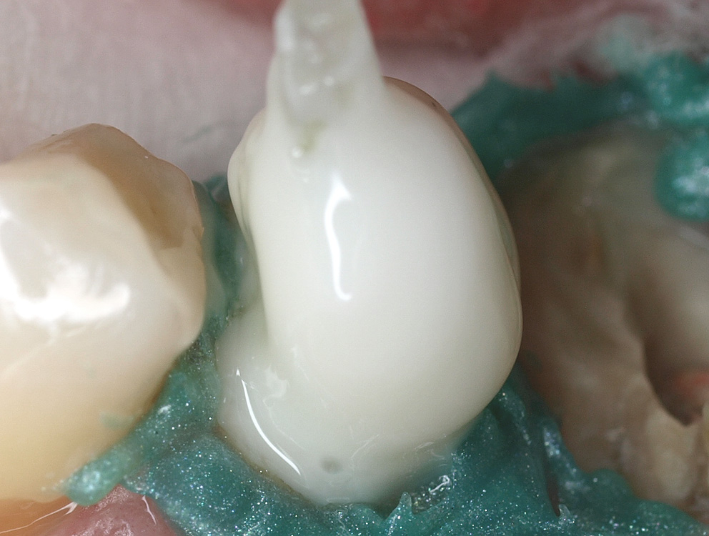
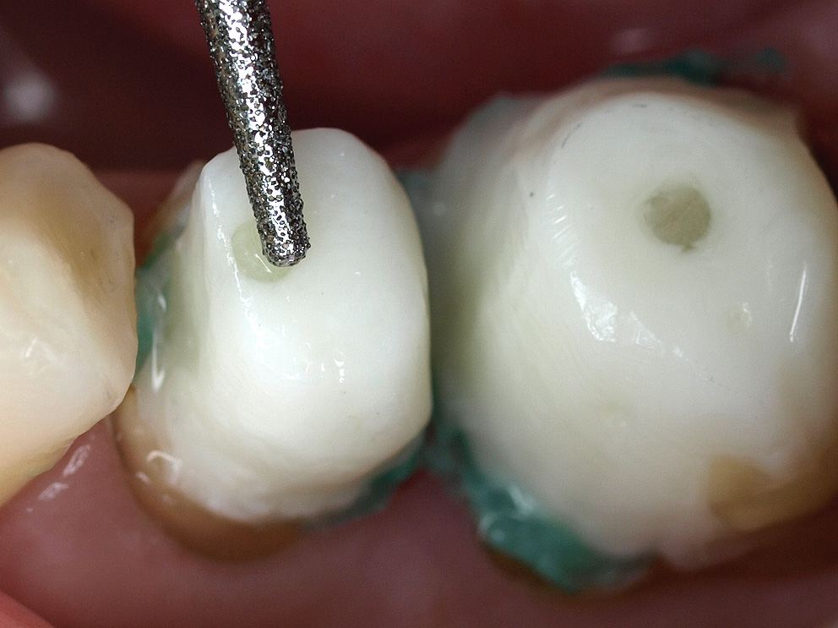
7. Apply adhesive bonding agent on tooth,
according to manufacturer’s instructions.
8. Inject or apply the dual-cure resin cement.
9. IMMEDIATELY insert the post. Light-cure.
10. Apply additional core material, and light-cure thoroughly.
11. Finish the core build-up.
12. Finished case ready for impression and
temporization.

Slide 4
The maxillary pre-molar (and first molar) required replacement of direct restorations, and an all-ceramic crowns are indicated.
This post system has the correct taper to approximate the existing root canal and a good selection of diameters, to adequately fill the space and provide retention.
Products used in this case:
RTD Macro-Lock Post, Size #1 (of 4)
VOCO Futurabond DC Bonding Agent
VOCO Rebuilda DC dual-cure resin cement and core composite
Affiliations:
Private practice; Sao Paulo, Brazil

