Slide 1
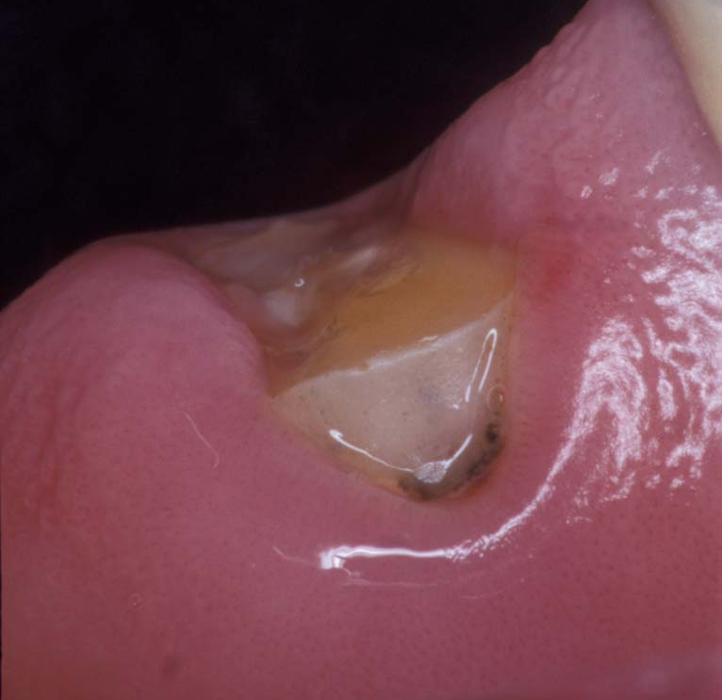
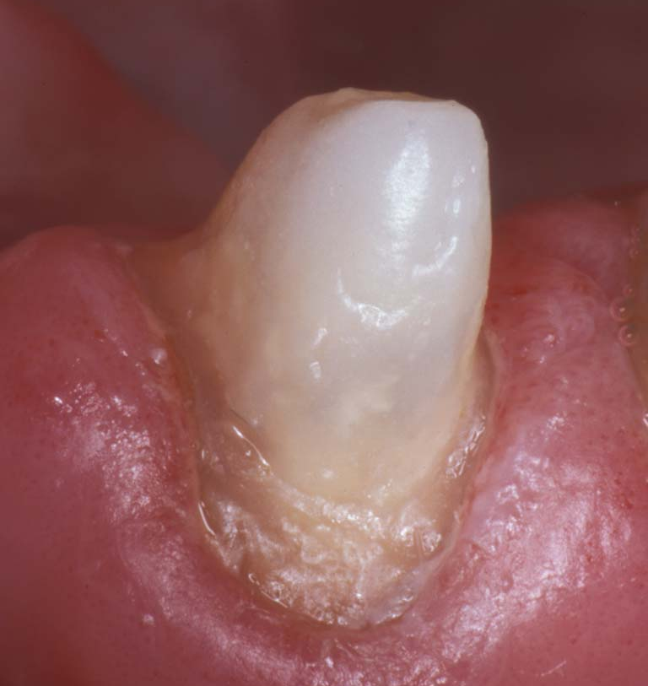
July, 2003
Clinical Case: DT Light-Post
Clinical case by:
Dr. Dernard Duret
This patient presented with a restoration on endodontically-treated incisor that failed right at the gum-line. Tooth structure is minimal, and the patient declined an implant for financial reasons.
A DT Light-Post Size #3 will be required for retention and support in the absence of adequate coronal tooth structure.

Slide 2
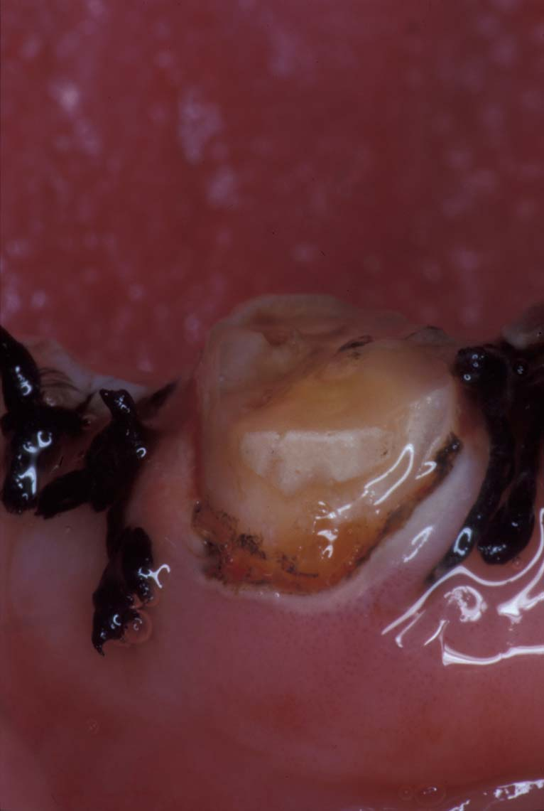
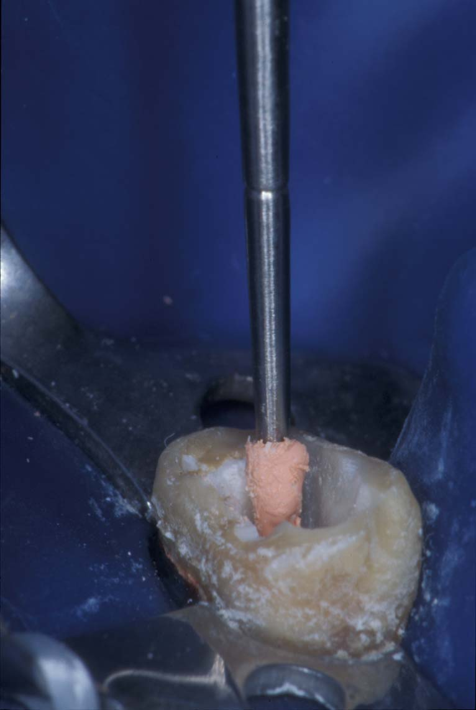
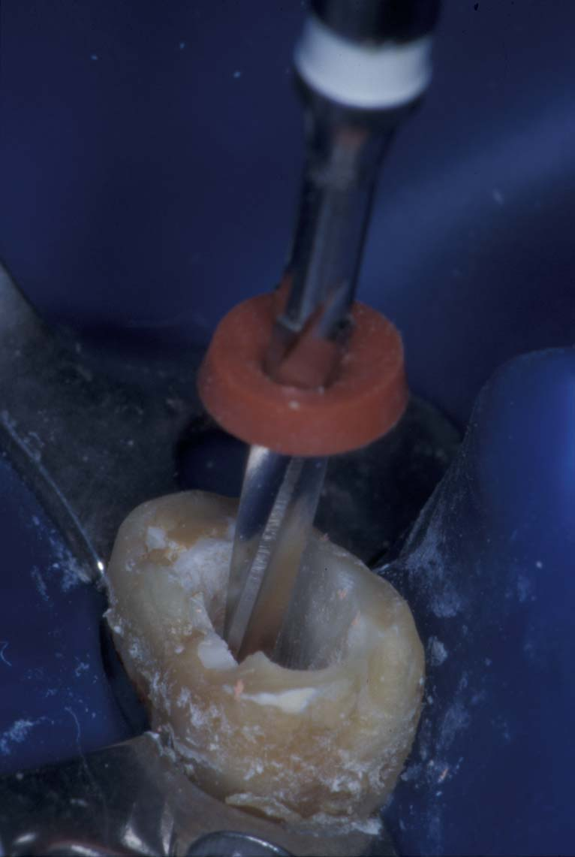
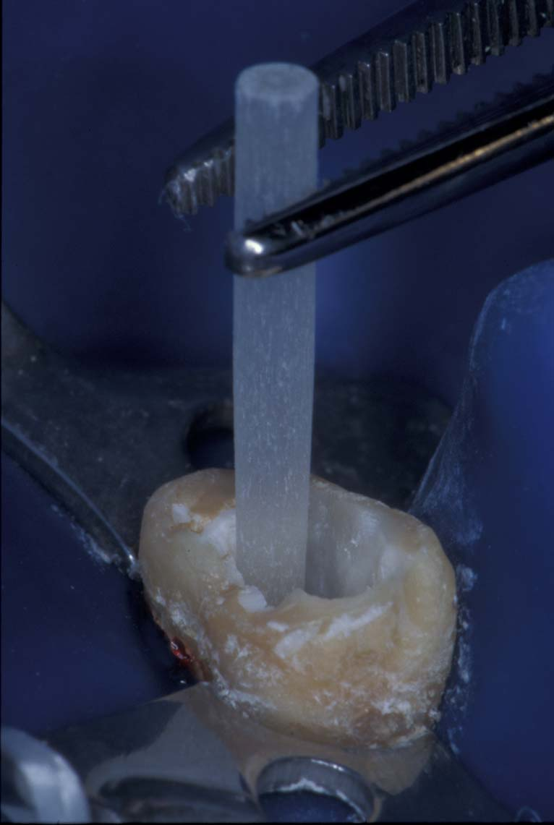
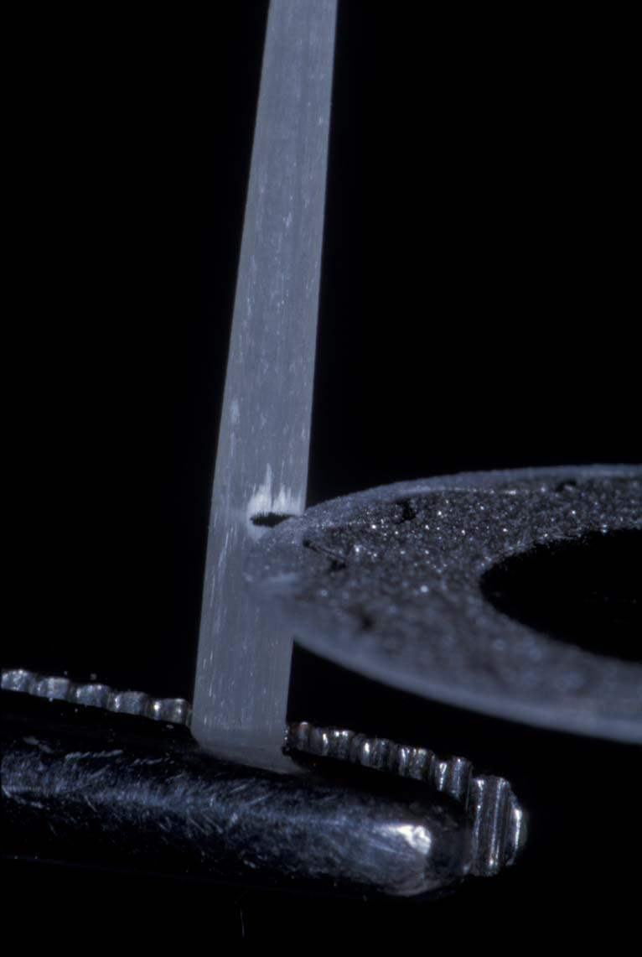
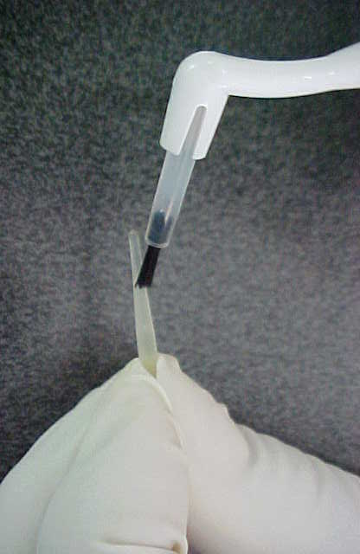
Surgical crown lengthening is performed, to allow for adequate ferrule.
2. Remove Gutta Percha as needed with Universal Starter Drill, confirming a seal apically.
3. After depth is established with the Starter Drill, shape is finalized with Finishing Drills.
4. The DT Light-Post is tried- in, optimizing the fit apically.
5. The post is trimmed with a disk or bur. NEVER use pliers. Clean with alcohol.
6. Coat the cleaned post with adhesive bonding agent. Air-dry. Light-cure. Set aside.

Slide 3
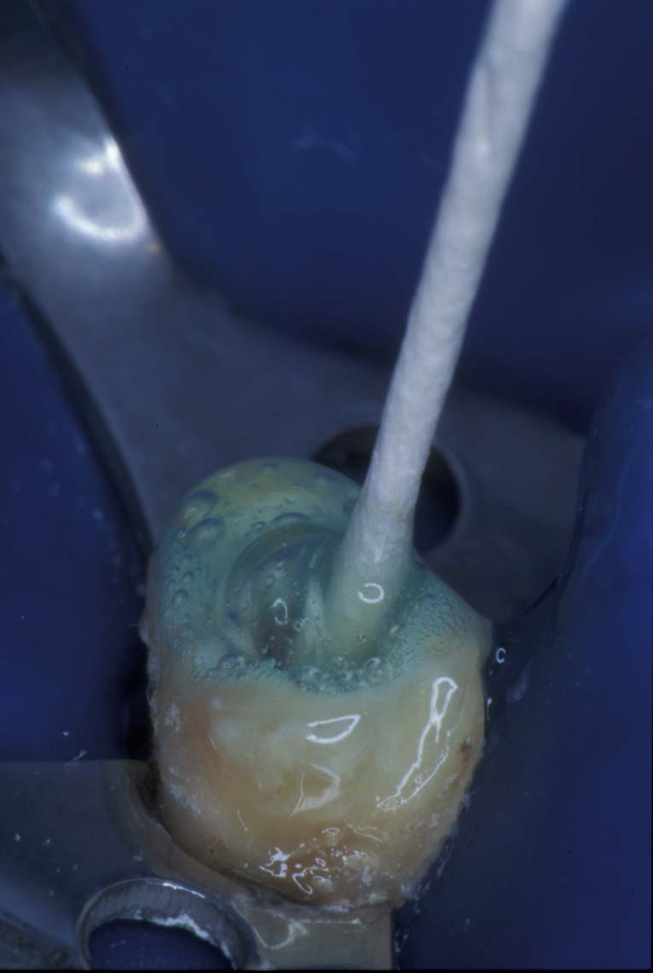
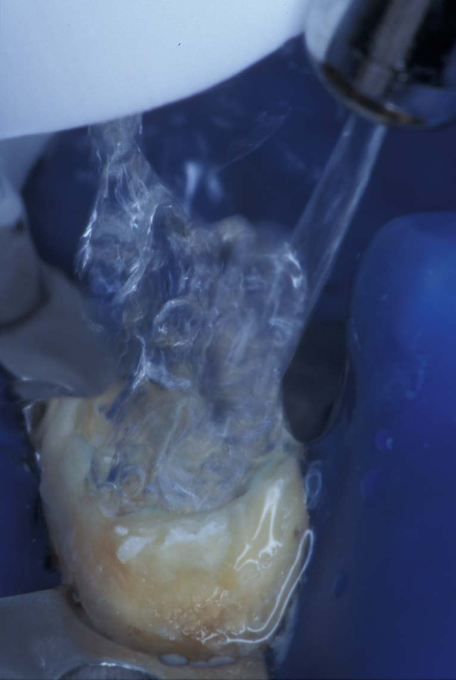
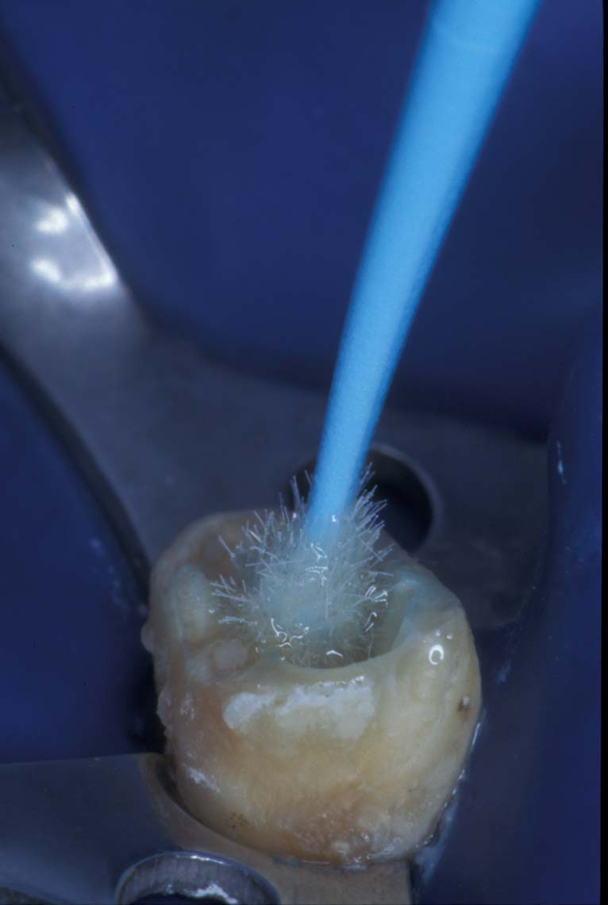
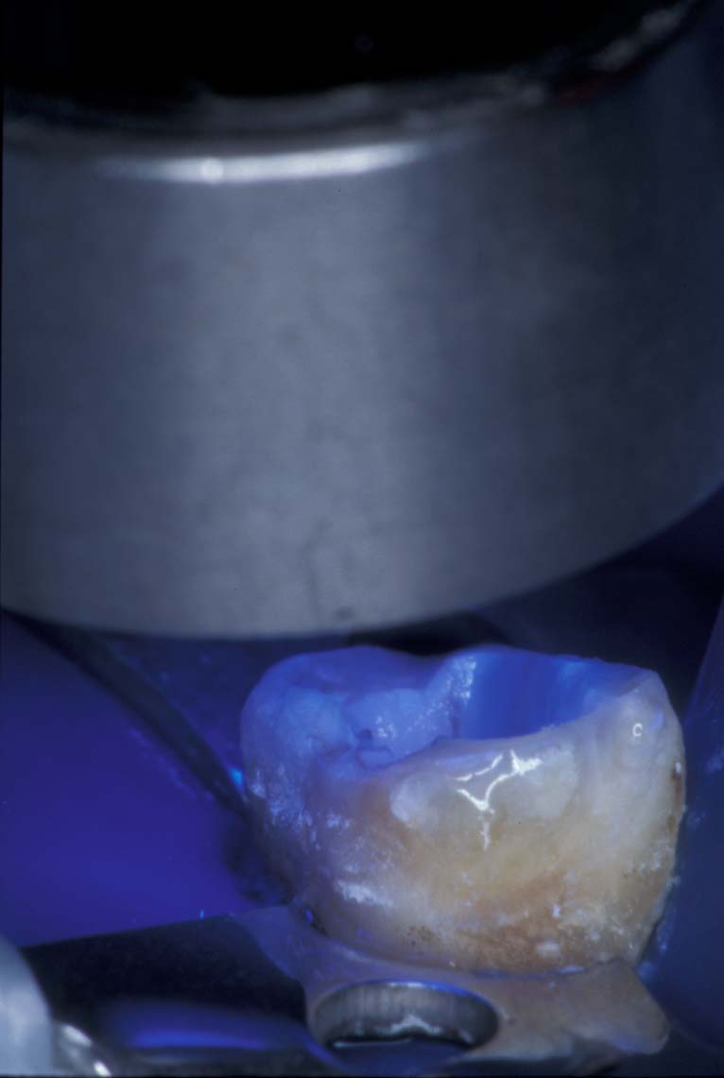
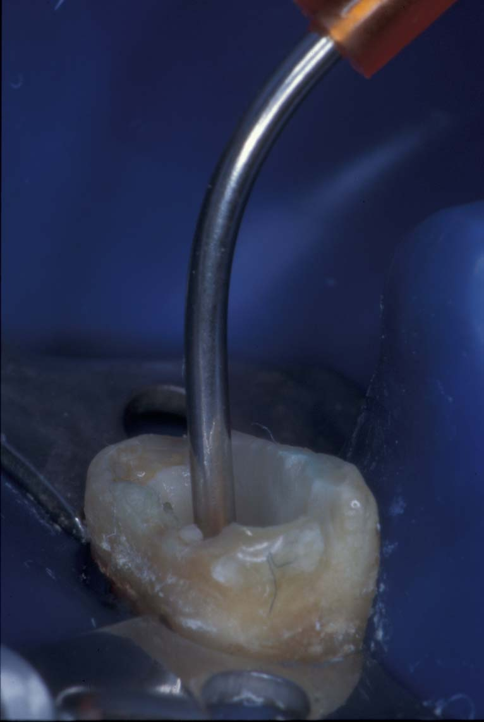
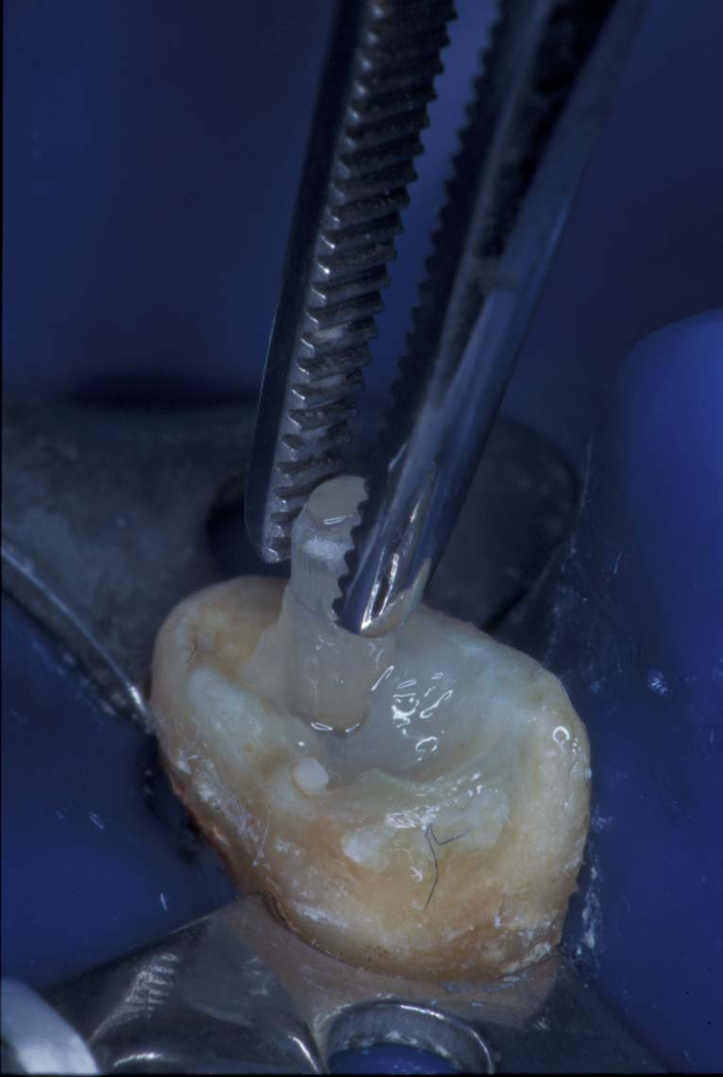
7. Etch the post space and circumferential tooth structure per Mfgr’s Instruction.
8. Rinse out the etchant. Remove excess water, leave tooth structure moist.
9. Apply adhesive bonding agent. Remove excess. Air dry to evaporate solvent.
10. Light-cure the bonding agent.
11. Inject DUAL-CURE resin cement.
12. Immediately insert post with gentle passive pressure. Light-cure to stabilize the post.

Slide 4
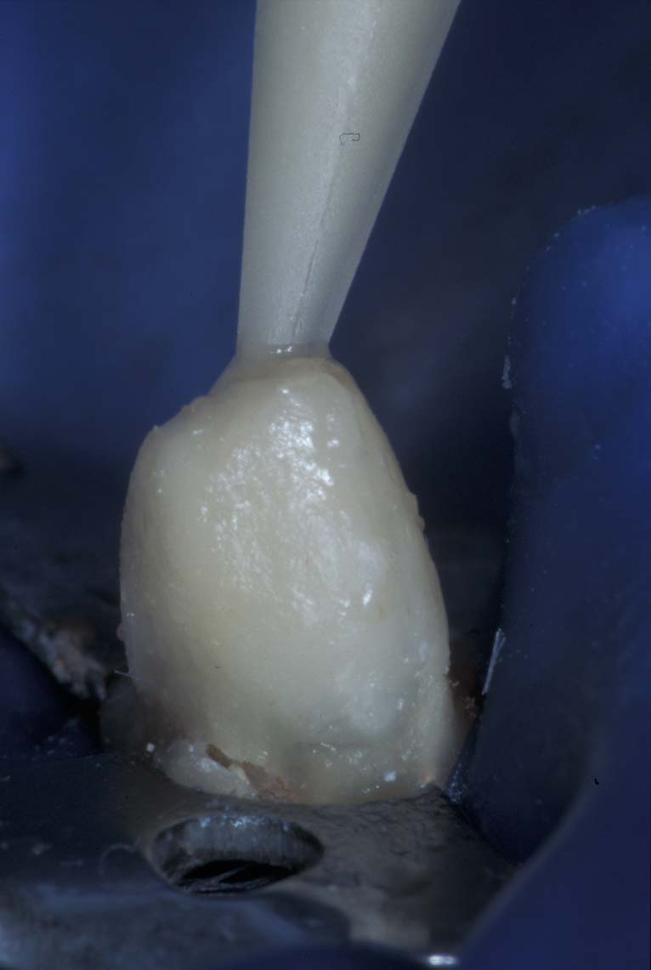
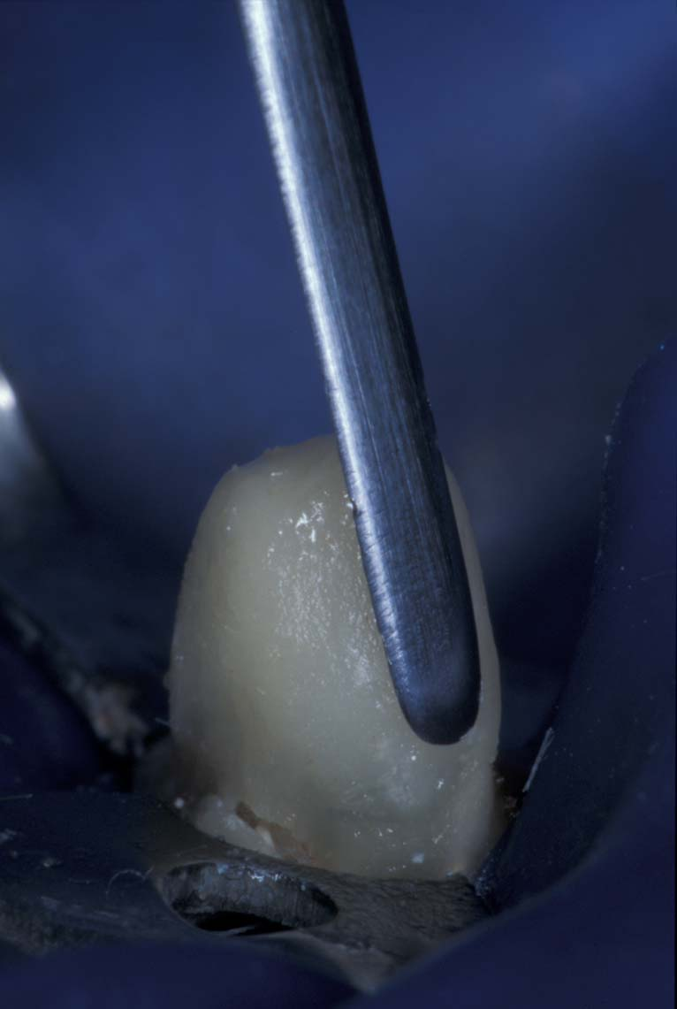
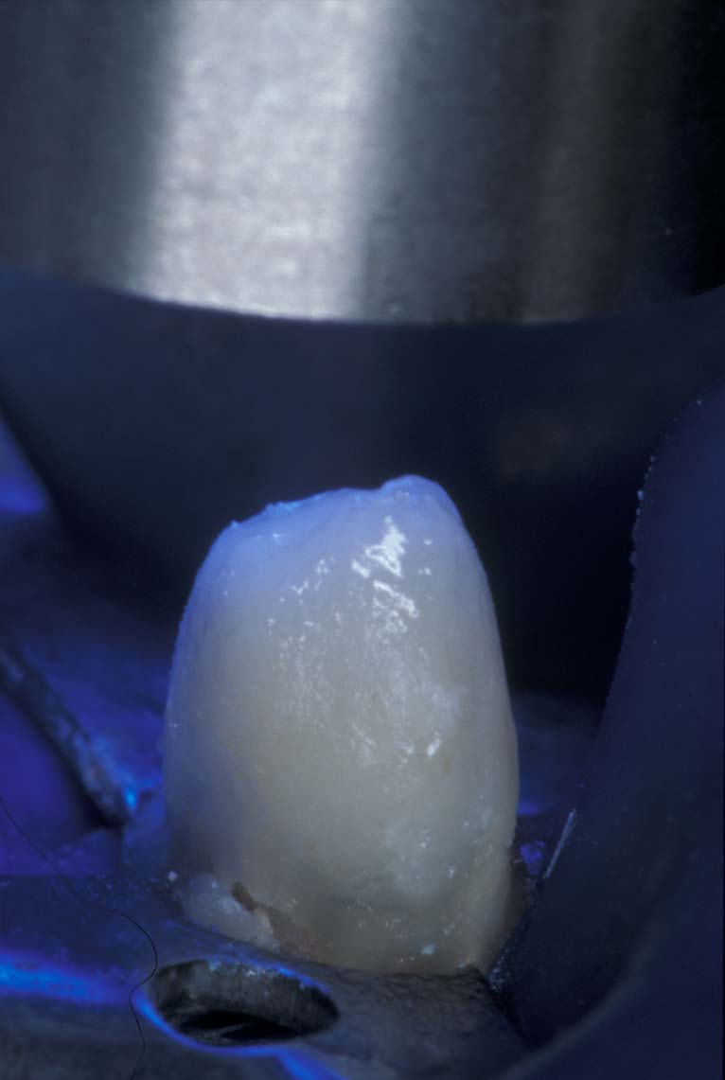
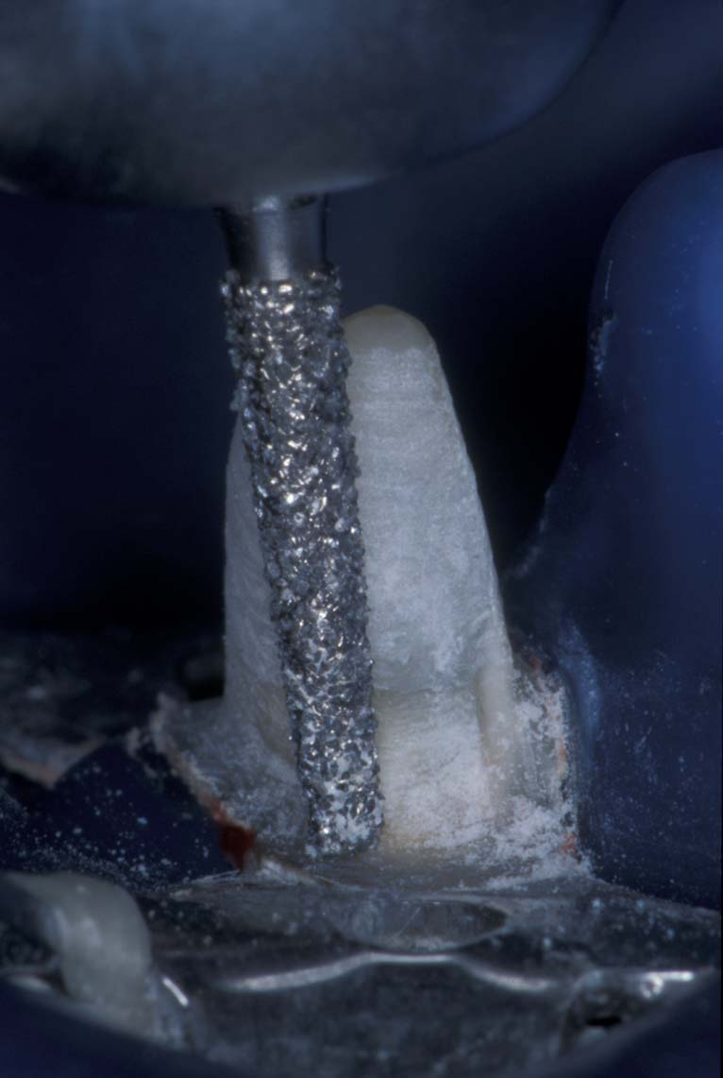
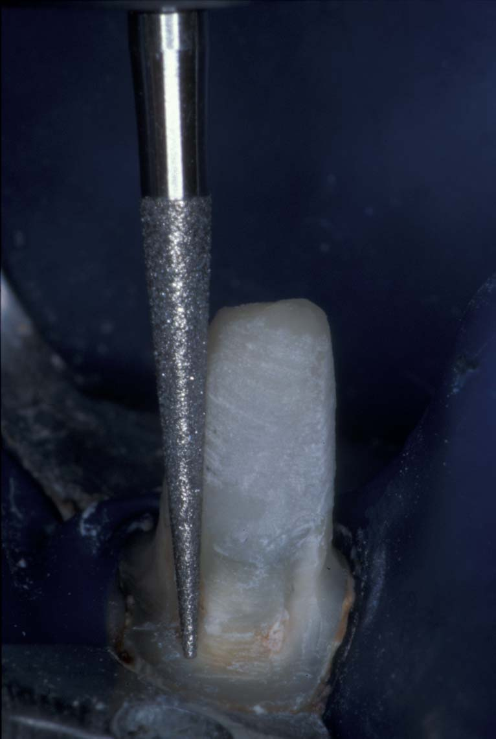
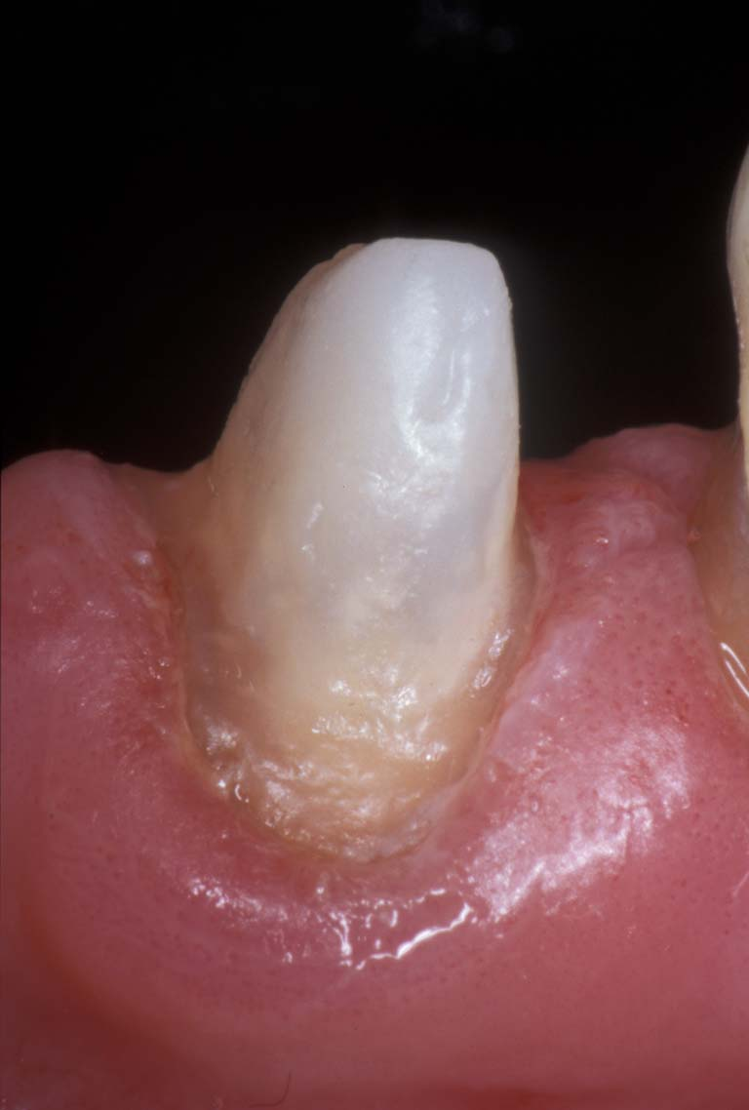
13. Apply dual-cure or light-cure core build-up composite.
14. Sculpt the core build-up.
15. Light-cure the core build-up.
16. Trim the core build-up, creating ferrule and shoulder .
17. Finish the build-up
18. Finished build-up; Impression and temporize.

Slide 5
The DT Light-Post has a double-tapered, anatomic design, to provide a good fit with minimal cement thickness.
After crown lengthening, there was sufficient remaining tooth structure to attain a ferrule, and a post was added to provide support for the prosthetic restoration.
In vitro research indicates that the addition of a quartz fiber post in anterior endodontically-treated teeth provides a more durable restoration with better failure modes.
Products used in this case:
RTD DT Light-Post
Bisco Uni-Etch with BAC
Bisco One-Step Adhesive (5th Generation)
Bisco Light-Core
Affiliations:
Dr. Duret practiced general dentistry in Grenoble, France. As a consultant to RTD, he was instrumental in the development of fiber-reinforced endodontic posts. Dr. Duret passed in 2015.
.

