Slide 1
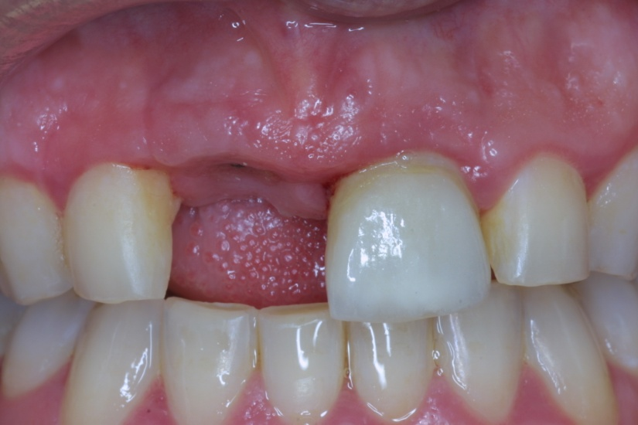
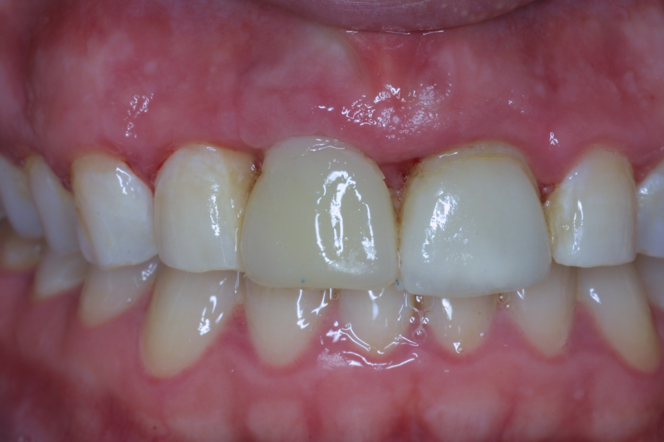
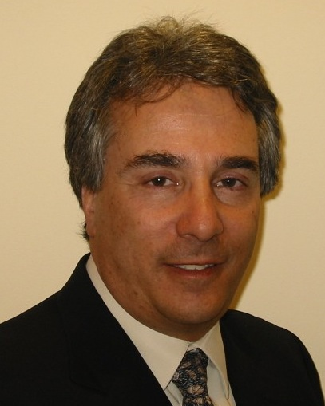
July, 2012
Clinical Case: Quartz Splint Woven- Single Tooth Replacement
Clinical case by:
Dr. Enrique Kogan Frenk
Tooth #8 was extracted, and was non-carious. Adjacent teeth were non-carious and overall hygiene was sufficient. Economics and sacrifice of abutment teeth were issues, and it was decided to bond the rootless tooth back into place, at least as a semi-permanent remedy.
Quartz Splint Woven was selected as the ”matrix” to suspend the tooth, primarily because of its reported strength, and ability to adapt to contour.

Slide 2
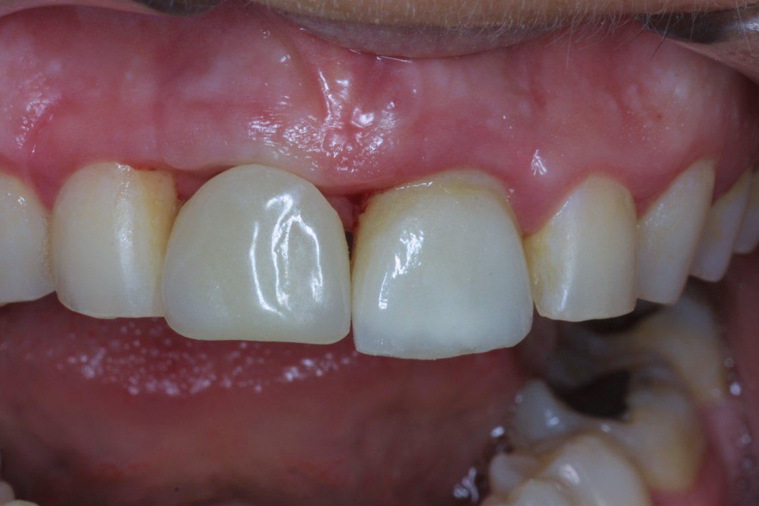
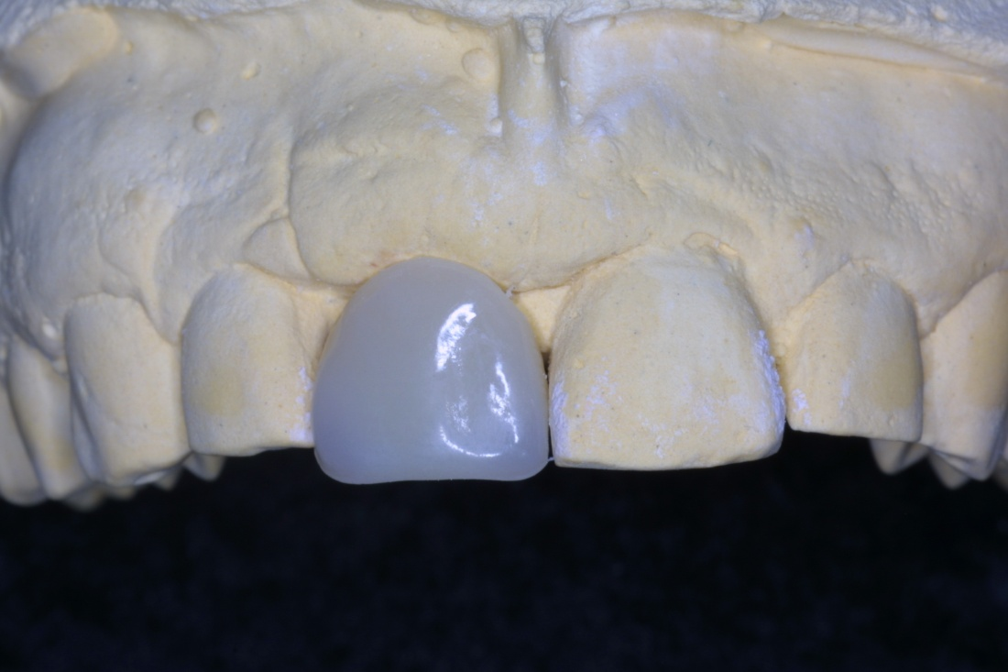
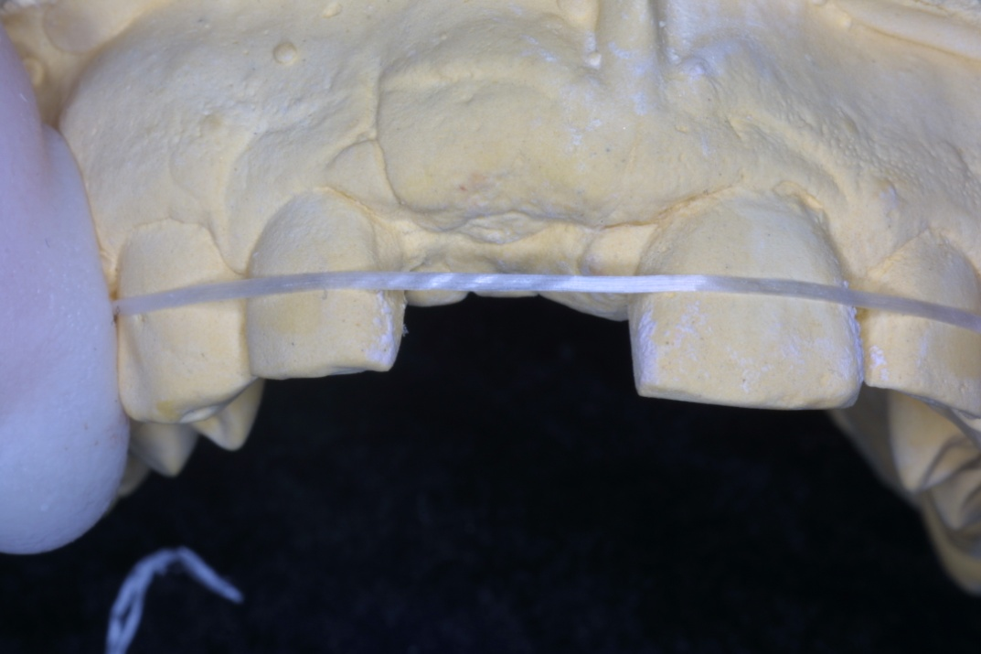
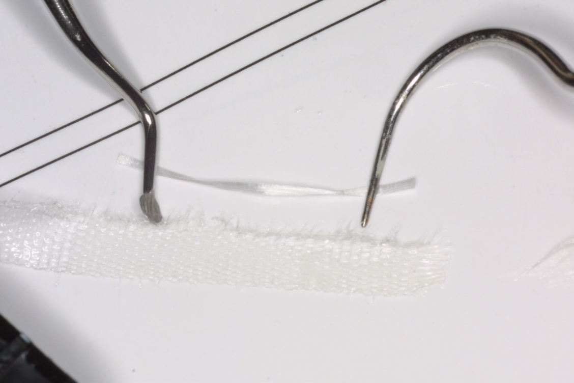
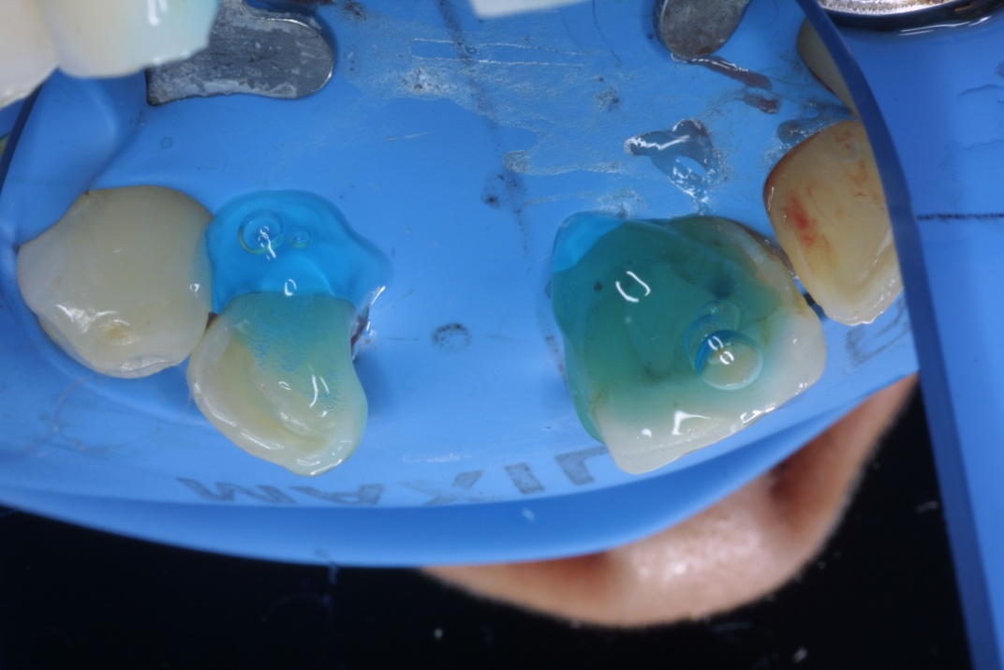
1. Remove the root from the extracted tooth, clean/seal appropriately, and try- in.
2. Create a stone model for sizing and convenience.
3. Create a horizontal slot on the lingual surface to hold the fibers and the resins.
Etch, rinse and apply bonding agent to entire lingual surface. Air-dry. Light-cure
4. Use loss or tape as an “analog” to
determine length of the strand of fibers.
5. Remove the pre-wetted fibers from the light-proof container, cut to length, and protect from light to prevent premature polymerization.
6. Isolate the operative site, and etch the attachment surfaces. Rinse, remove excess water.

Slide 3
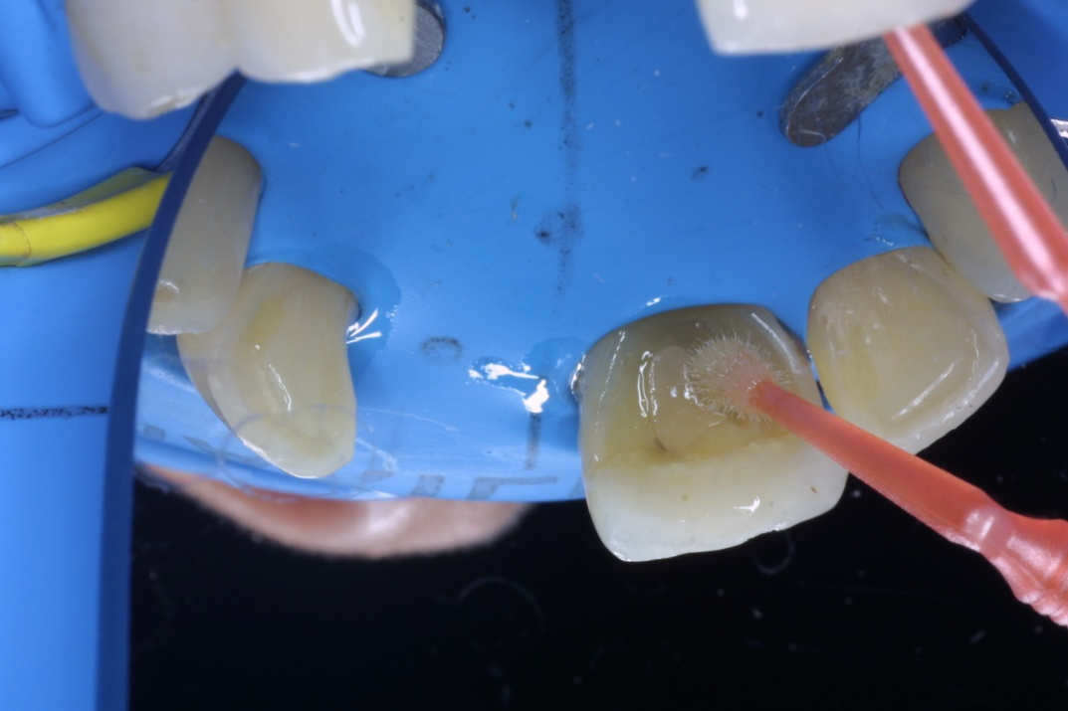
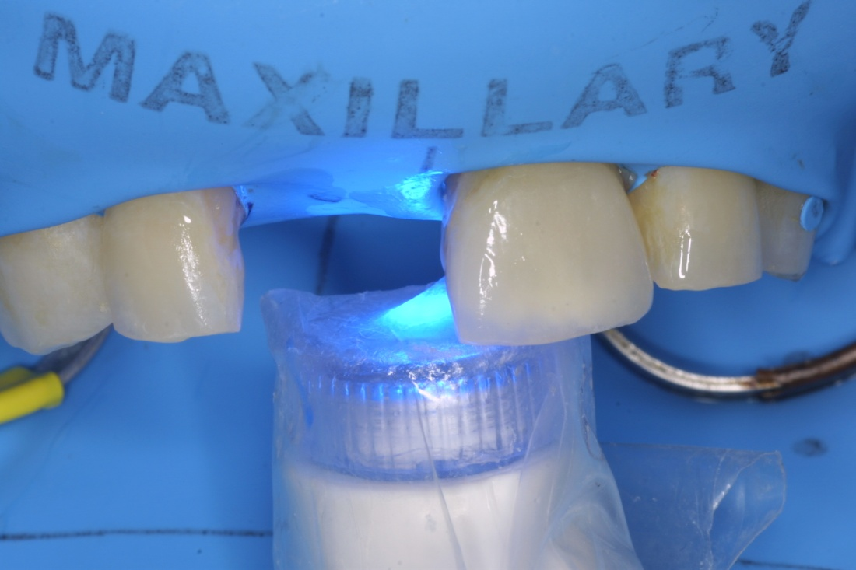
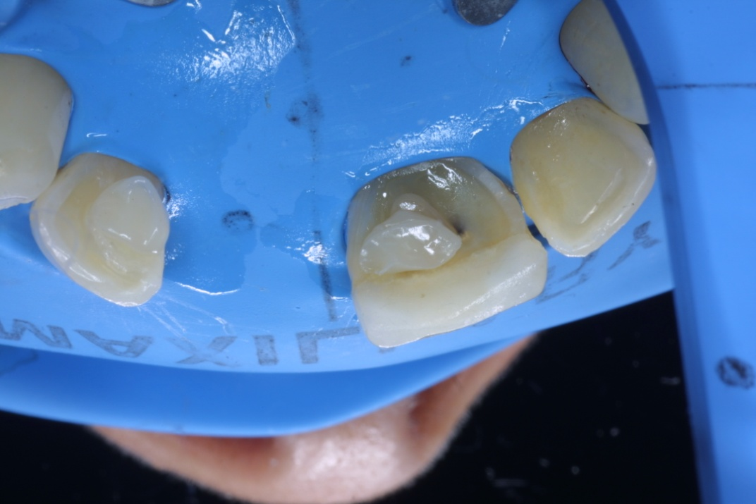
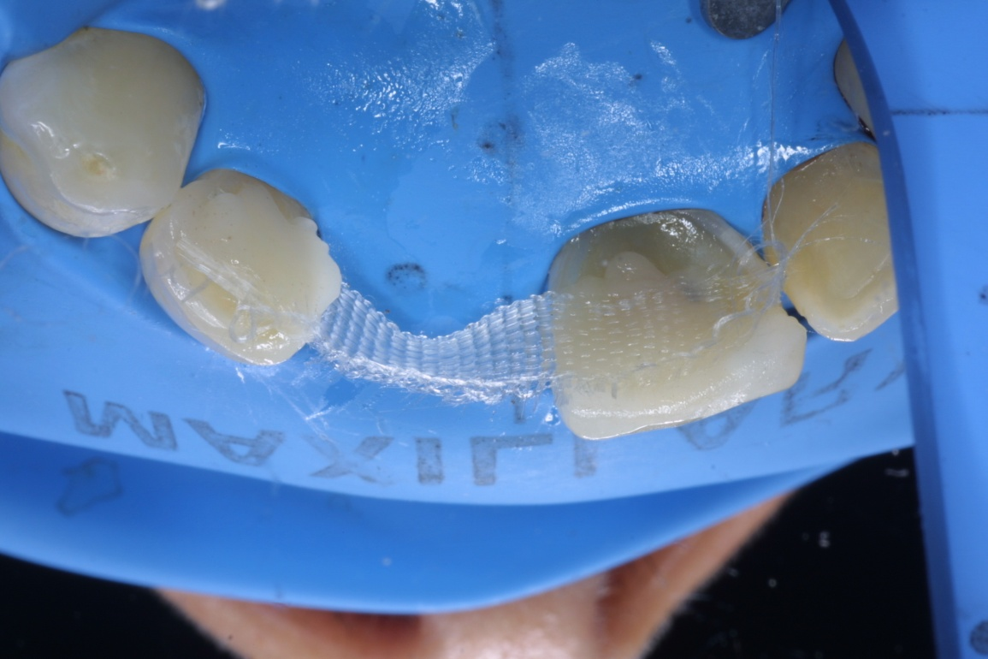
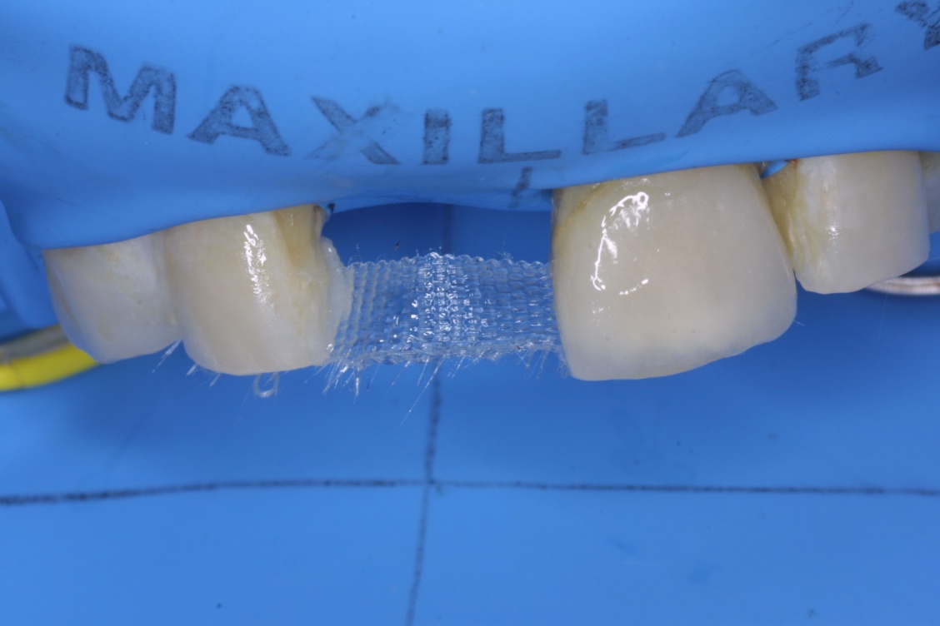
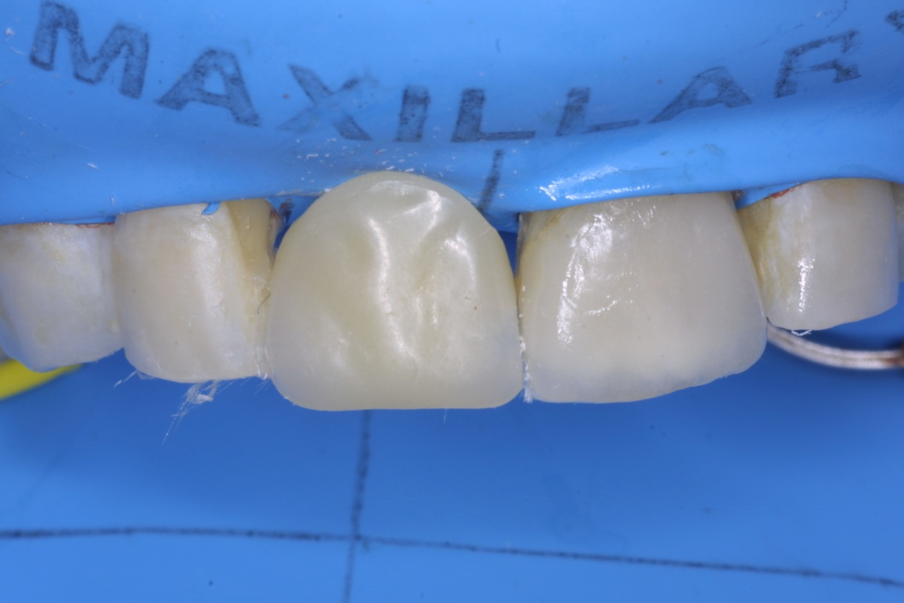
7. Apply light-cured adhesive Bonding Agent to the involved surfaces.
8. Remove excess. Air-dry. Light-cure.
9. Place a pad of flowable composite onto the active bonding surfaces. DO NOT light-cure.
10. Place the QS Woven into the composite., and assure a path of insertion for the tooth.
Light-cure the QS on the tooth lingual. Do NOT cure the “suspension” area yet
11. The QS Woven is now a “back wall”, attached to both abutments.
12. Load composite into the slot in the lingual of the tooth, and wiggle into place. SPOT CURE when in place.

Slide 4
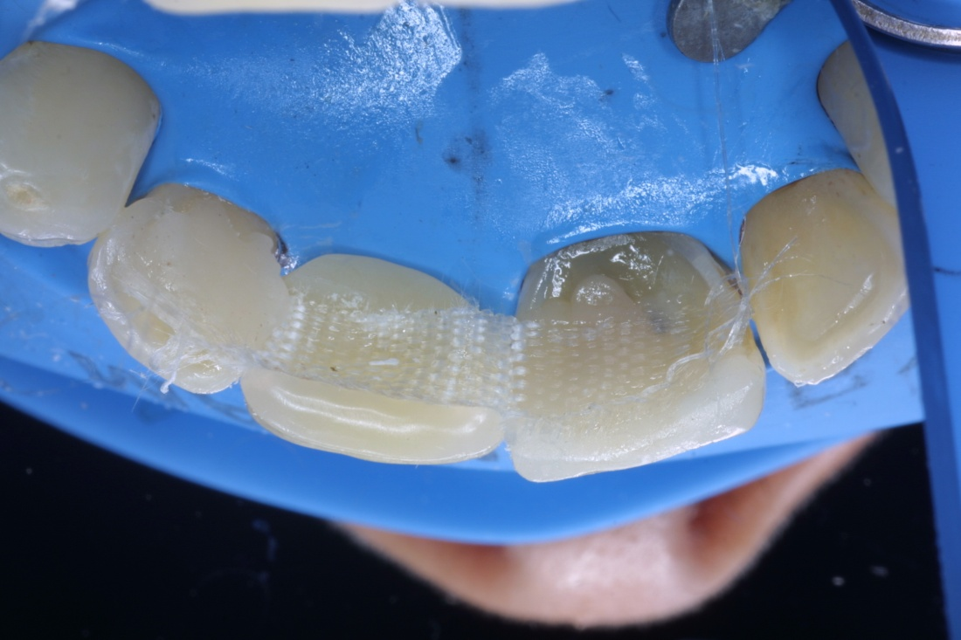
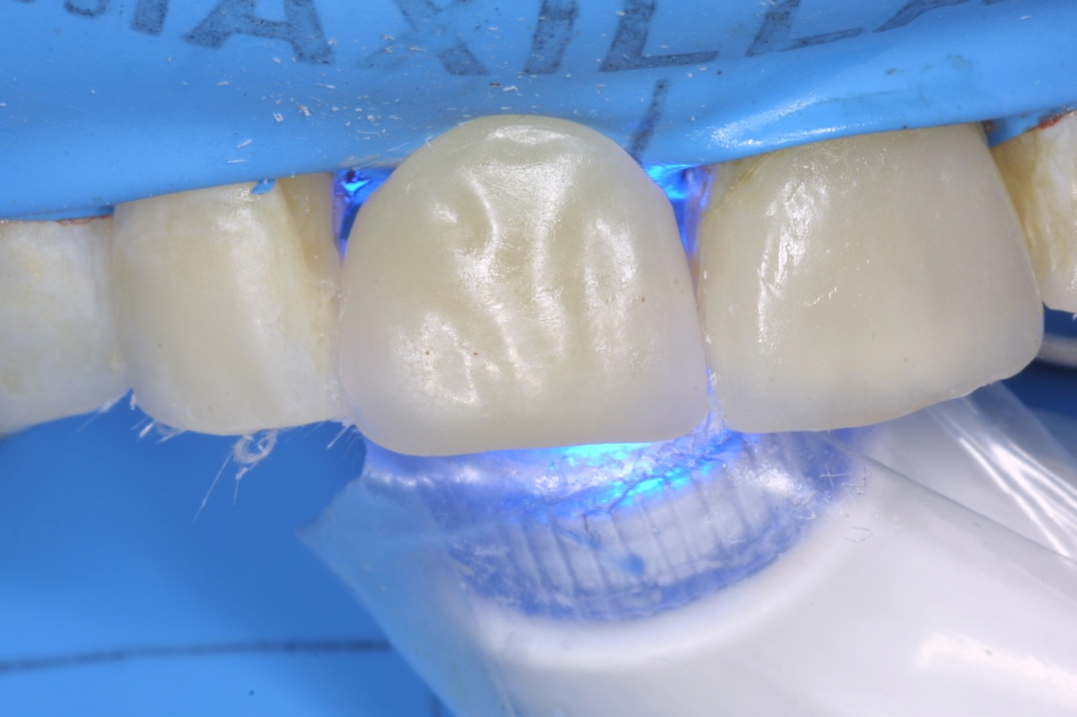
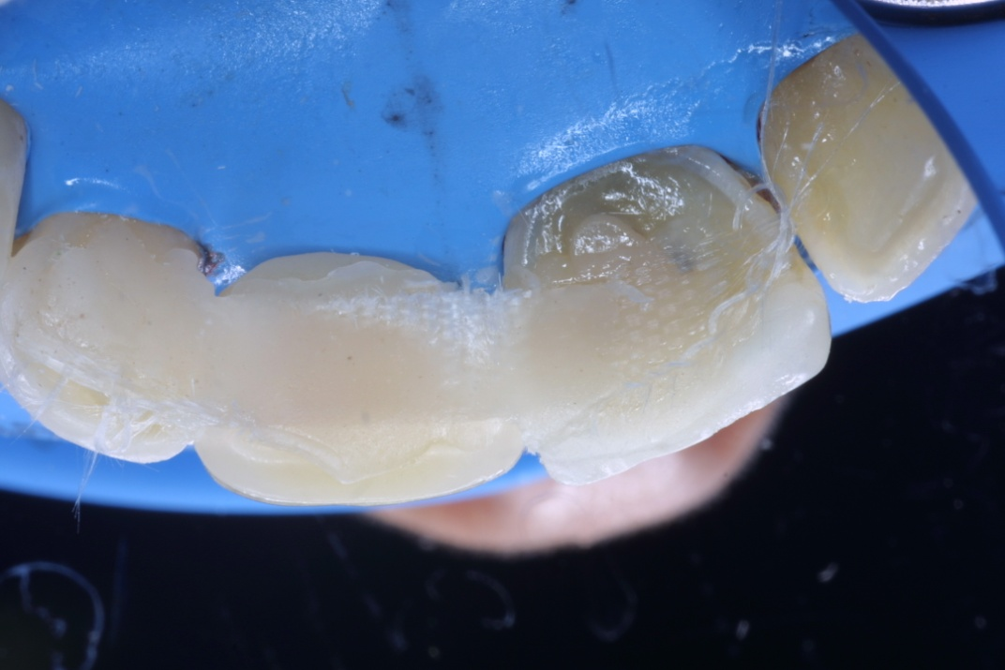
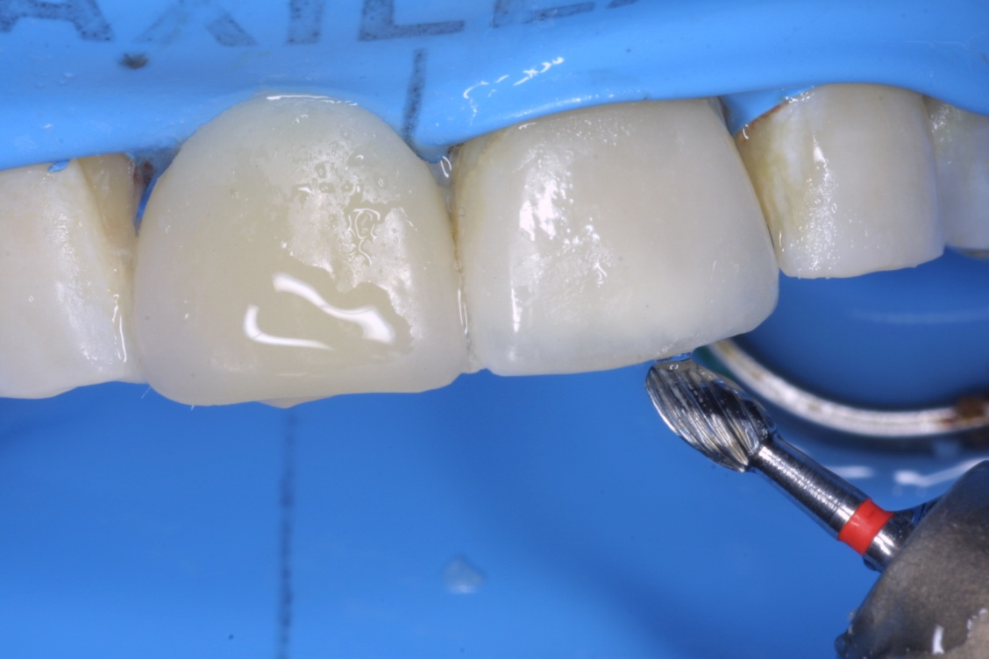
13. Cover the QS Woven with composite.
14. Light-cure the entire restoration.
15. Confirm that all of the fibers are covered with composite. Add more, if needed, and light-cure.
16. Finish the contour and polish, as needed, and
eliminate bite/closure interference.
17. Finished case.

Slide 5
The concept of a aesthetic, bonded bridge is not a new idea. The Maryland bridge was introduced in the 1980s with the objective of spirit valuable to structure on the abutment teeth; bonding “clasps” those quote to lingual surfaces of those abutment teeth.
Use of fiber reinforced composite as a temporary or semi-permanent structure has been around nearly as long, and has improved as the fibers, composites, and adhesive systems improved. The technique demonstrated here could be performed using the natural tooth, a denture tooth, or a tooth made from high-quality composite. Because the natural (extracted) tooth was in good condition, it was used; to prevent conflicts of shading, symmetry or anatomy with its contrapositive.
This technique might also be ideal for post-implant placement as a temporary restoration, for periodontal situation where the tooth has evulsed , or in the case of accident/trauma.
Regardless, the technique is a straightforward one-appointment technique that requires no laboratory fee and dramatically conserves tooth structure, should reversal and/or more expensive treatment become necessary subsequently.
Quartz Splint fibers are available in Unidirectional, Woven, Rope and a Mesh, but the woven was selected for this case because of the peculiar contours of the lingual surfaces, and the ability of the Woven to adapt without “memory”. In the case of a posterior span, it is likely that the Unidirectional version would be preferred, because of the additional strength.
Products used in this case:
RTD Quartz Splint (Woven)
Bisco Uni-Etch
RTD Sealbond Ultima Adhesive (5th Generation)
RTD Quartz Splint Flow (flowable composite)
Affiliations:
Dr. Kogan Frenk is a Prosthodontist in Mexico City, Mexico.

