Slide 1
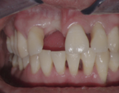
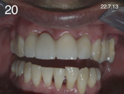
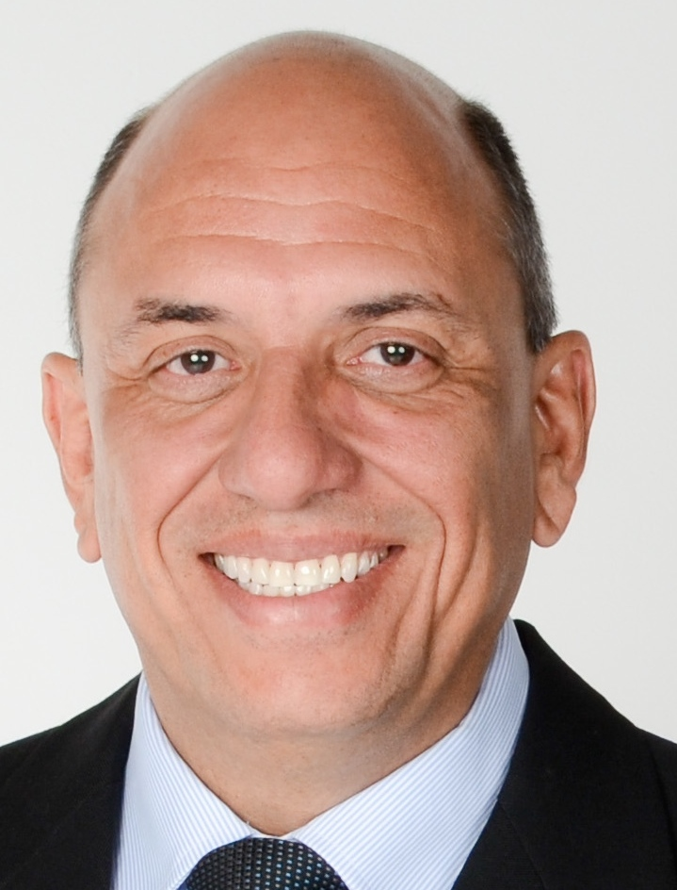
September, 2018
Clinical Case: Quartz Splint UD , Tooth Replacement (Composite)
Clinical case by:
Dr. Mario Rodiguez Posada
The sequelae of untreated periodontitis is a big problem, many times, leading to the following:
Increased tooth mobility resulting from bone loss.
Gum recession
Over eruption of teeth
Patient lack of self-esteem due to poor dental aesthetics
Dental implants, bone grafts and fixed partial dentures are considered to be expensive treatments for patients
Difficulty in attaining desired objectives with complex restorations .
Not all patients are candidates for implants, and perio-restorative therapy using fiber and composite have been a staple in my practice for 18 years, achieving a reliable, economic result in one appointment.

Slide 2
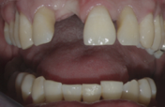
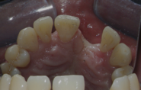
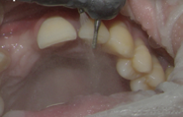
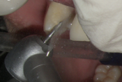
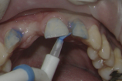
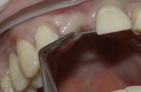
I have been using dental fiberglass in my practice for 18 years with excellent results, having resolved approximately 700 simple to complex cases with excellent and lasting results. The case that I selected reflects how a difficult dental case was able to be resolved satisfactorily in just a few hours.
The patient is a 33 year-old male referred to me by his periodontist The upper central and the lateral incisors had Grade 1 Mobility based on Nyman´s et al Mobility Index . Number 9 was missing.
1. Occlusion was analyzed as well as the amount of reduction required.
.
2. Four mobile teeth were splinted to stabilize them.
3. Tooth preparation was performed in the incisal and buccal region.
4. Palatal Class III cavity preparations were done on abutment teeth, considering spacing required to include fiber thickness and outer resin layer.
.
5. Phosphoric acid was placed according to Manufacturer Instructions.
6. The distance between the Class III preparations was measured with a piece of wire.

Slide 3
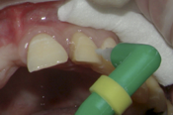
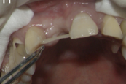
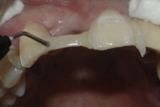
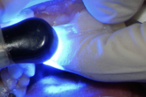
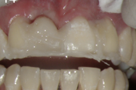
7. The QS fibers were cut to match the wire analog.
8. A layer of bonding resin was applied, and light-cured.
9. A flowable composite was placed in the Class III preps, and on the ends of the cut fibers. The fiber “span” is positioned and light-cured.
10. The structure is incrementally con-structed by adding layers of the Quartz Splint and Flowable, and light-cured.
11. The pontic is built by adding composite and fibers, light-curing each increment.
12. A diamond bur is used to shape the composite teeth.

Slide 4
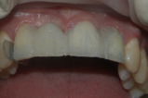
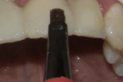
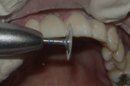
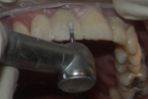
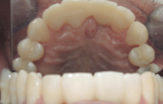
13. Teeth are etched again and more adhesive applied.
14. A final layer of strong, nano-filled composite is placed, sculptured and light-cured with each layer.
15. Interdental areas were shaped with diamond discs at low speed.
16. High-gloss polishing is accomplished with the usual armamentarium.
17. The occlusion was checked, adjusted as needed. Very good stability and esthetics are economically achieved in one appointment.
.
18. Four years later, the splint is still in good shape with an adequate shine, fit and shade

Slide 5
Quartz Splint fibers are available in Unidirectional, Woven, Rope and a Mesh. The Uni-Directional was selected for this case because of the high mechanical properties”.
Unfortunately, in this case, an implant would not resolve the significant amount of bone loss in tooth 1.1 and the mobility of the teeth. Placement of an implant, for this case, would be challenging as would be the possibility of attaining a good aesthetic result.
The advantages of using fiberglass splints include:
Impressive tooth stability
No need for excessive reduction of teeth
Good aesthetic results
Short duration of the procedure which lasts 2-3 hours.
Easily repairable
No need to use a dental laboratory
The dentist has total control of the results, occlusion, shade and fit
Predictable results
Biocompatible material
Patients are extremely satisfied with the results.
Products used in this case:
RTD Quartz Splint (UD)
3M Universal Single Bond
3M Nano-filled Filtek Z350 Flowable composite
3M Universal Composite
Affiliations:
Dr. Rodriguez Posada maintains a private practice in San Jose, Costa Rica.

